Slide 1
Java Programming
2

Slide 2
Conditional Statements in Java are:
if statement nested if statement if-else statement if-else-if statement Switch Case Statement

Slide 3
Condition for if else
if(condition)
{
//the code to be executed if the condition is true
}
if(condition)
{
//the code to be executed if the condition is true
}
else{
//the code to be executed if the condition is false
}

Slide 4
Condition for Switch Statement
switch(expression)
{
case a:
//code
break;
case b:
//code
break;
default:
} //code

Slide 5
Condition for if else Statement
if(condition1) {
statement(s); /*if condition1 is true execute this*/
}
else if(condition2) {
statement(s); /* execute this if condition1 is not met and * condition2 is met*/
}
else if(condition3) {
statement(s); /* execute this if condition1 & condition2 are not met and condition3 is met*/
}
else {
statement(s); /* if none of the condition is true* then these statements gets executed*/
}

Slide 6
LOOPS
Loops:
Loops are an important concept in programming that allows the programmer to iterate over the sequence of statements.
Loop is designed to execute particular code block till the specified condition is true.
Different Types of Loop:
For loop
While loop
Do while loop

Slide 7
LOOPS
Do-while loop:
The do-while loop is a variant of the while loop. This loop will execute the code block once, before checking if the condition is true, then it will repeat the loop as long as the condition is true.
While loop:
The while loop loops through a block of code as long as a specified condition is true.
For loop:
The for loop is used for executing a part of the program repeatedly. When the number of execution is fixed then it is suggested to use for loop.

Slide 8
CLASS
A class is a group of objects which have common properties. It is a template or blueprint from which objects are created. It is a logical entity. It can't be physical.
A class in Java can contain:
Fields
Methods
Constructors
Blocks
Nested class and interface
Class in Java
Syntax to declare a class:
class <class_name>{
field;
method;
}

Slide 9
OBJECTS
It is a basic unit of Object-Oriented Programming and represents the real life entities. A typical Java program creates many objects, which as you know, interact by invoking methods. An object consists of :
State: It is represented by attributes of an object. It also reflects the properties of an object.
Behavior: It is represented by methods of an object. It also reflects the response of an object with other objects.
Identity: It gives a unique name to an object and enables one object to interact with other objects.

Slide 10
FINAL KEYWORD
Java final keyword is a non-access specifier that is used to restrict a class, variable, and method. If we initialize a variable with the final keyword, then we cannot modify its value.
If we declare a method as final, then it cannot be overridden by any subclasses. And, if we declare a class as final, we restrict the other classes to inherit or extend it.
In other words, the final classes can not be inherited by other classes.
This was a brief introduction to a final keyword in Java. Now we will discuss the implementation of the final keyword with a variable, method, and class in Java.
We will discuss the following topics in detail:
1. final variable 2. final class 3. final method

Slide 11
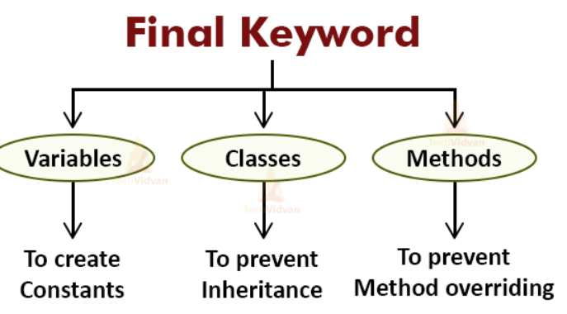

Slide 12
STATIC KEYWORD
The static keyword in Java is used for memory management mainly. We can apply static keyword with variables, methods, blocks and nested classes. The static keyword belongs to the class than an instance of the class.
The static can be:
Variable (also known as a class variable)
Method (also known as a class method)
Block
Nested class

Slide 13
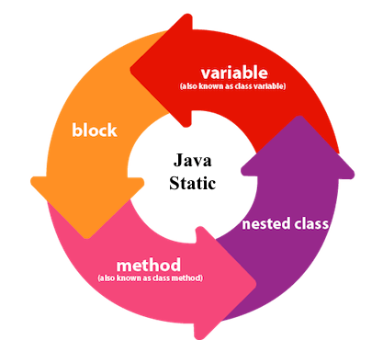
STATIC KEYWORD
If you declare any variable as static, it is known as a static variable.
The static variable can be used to refer to the common property of all objects (which is not unique for each object), for example, the company name of employees, college name of students, etc.
The static variable gets memory only once in the class area at the time of class loading.
Advantages of static variable
It makes your program memory efficient (i.e., it saves memory).

Slide 14
METHOD OVERLOADING
Overloading allows different methods to have the same name, but different signatures where the signature can differ by the number of input parameters or type of input parameters or both.
Overloading is related to compile-time (or static) polymorphism. We cannot overload two methods in Java if they differ only by static keyword (number of parameters and types of parameters is same).
We can have two or more static methods with same name, but differences in input parameters.

Slide 15
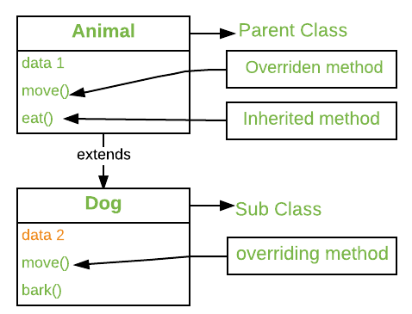
METHOD OVERRIDING
In any object-oriented programming language, Overriding is a feature that allows a subclass or child class to provide a specific implementation of a method that is already provided by one of its super-classes or parent classes. When a method in a subclass has the same name, same parameters or signature, and same return type(or sub-type) as a method in its super-class, then the method in the subclass is said to override the method in the super-class.
Method overriding is one of the way by which java achieve run time Polymorphism.

